Slide 1
Predicting And Analyzing Urban Water Quality
Using IBM Watson Machine Learning Service

Slide 2
TEAM MEMBERS
>>> ARE MANIKANTA SAI GOUD
>>> ARUTLA SREEVANI
>>> BAIRAJU KALYAN VARMA
>>> DACHU AMSHU
>>> BATHINI RASHIKA

Slide 3
INTRODUCTION
Water quality refers to the chemical, physical, and biological characteristics of water based on the standards of its usage.
Water is considered as a vital resource that affects various aspects of human health and lives. The quality of water is a major concern for people living in urban areas.
Quality of water serves as a powerful environmental determinant and a foundation for the prevention and control of waterborne diseases.

Slide 4
predicting the urban water quality is a challenging task since the water quality varies in urban spaces non-linearly and depends on multiple factors, such as meteorology, water usage patterns, and land uses, so this project aims at building a Machine Learning (ML) model by considering all water quality standard indicators.
we have designed a model for prediction of urban water quality for this prediction we have considered various water quality from various states

Slide 5
Some of the factors:
>>> CONDUCTIVITY
>>> NITRATENAN N+ NITRITENANN
>>> FECAL COLIFORM
>>> B.O.D ( biochemical oxygen demand )
>>> D.O(dissolved oxygen )
>>> PH

Slide 6
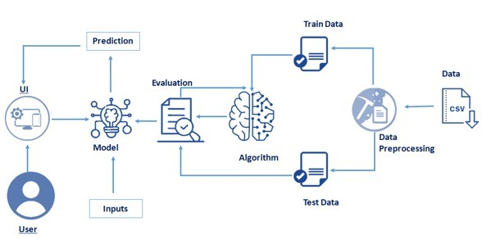
BLOCK DIAGRAM

Slide 7
FLOW CHART
Data Collection.
Collect the dataset or Create the dataset
Data Preprocessing.
Import the Libraries.
Importing the dataset.
Checking for Null Values.
Data Visualization.
Taking care of Missing Data.
Label encoding.
One Hot Encoding.
Feature Scaling.
Splitting Data into Train and Test.
Model Building
Training and testing the model
Evaluation of Model
Application Building
Create an HTML file
Build a Python Code

Slide 8
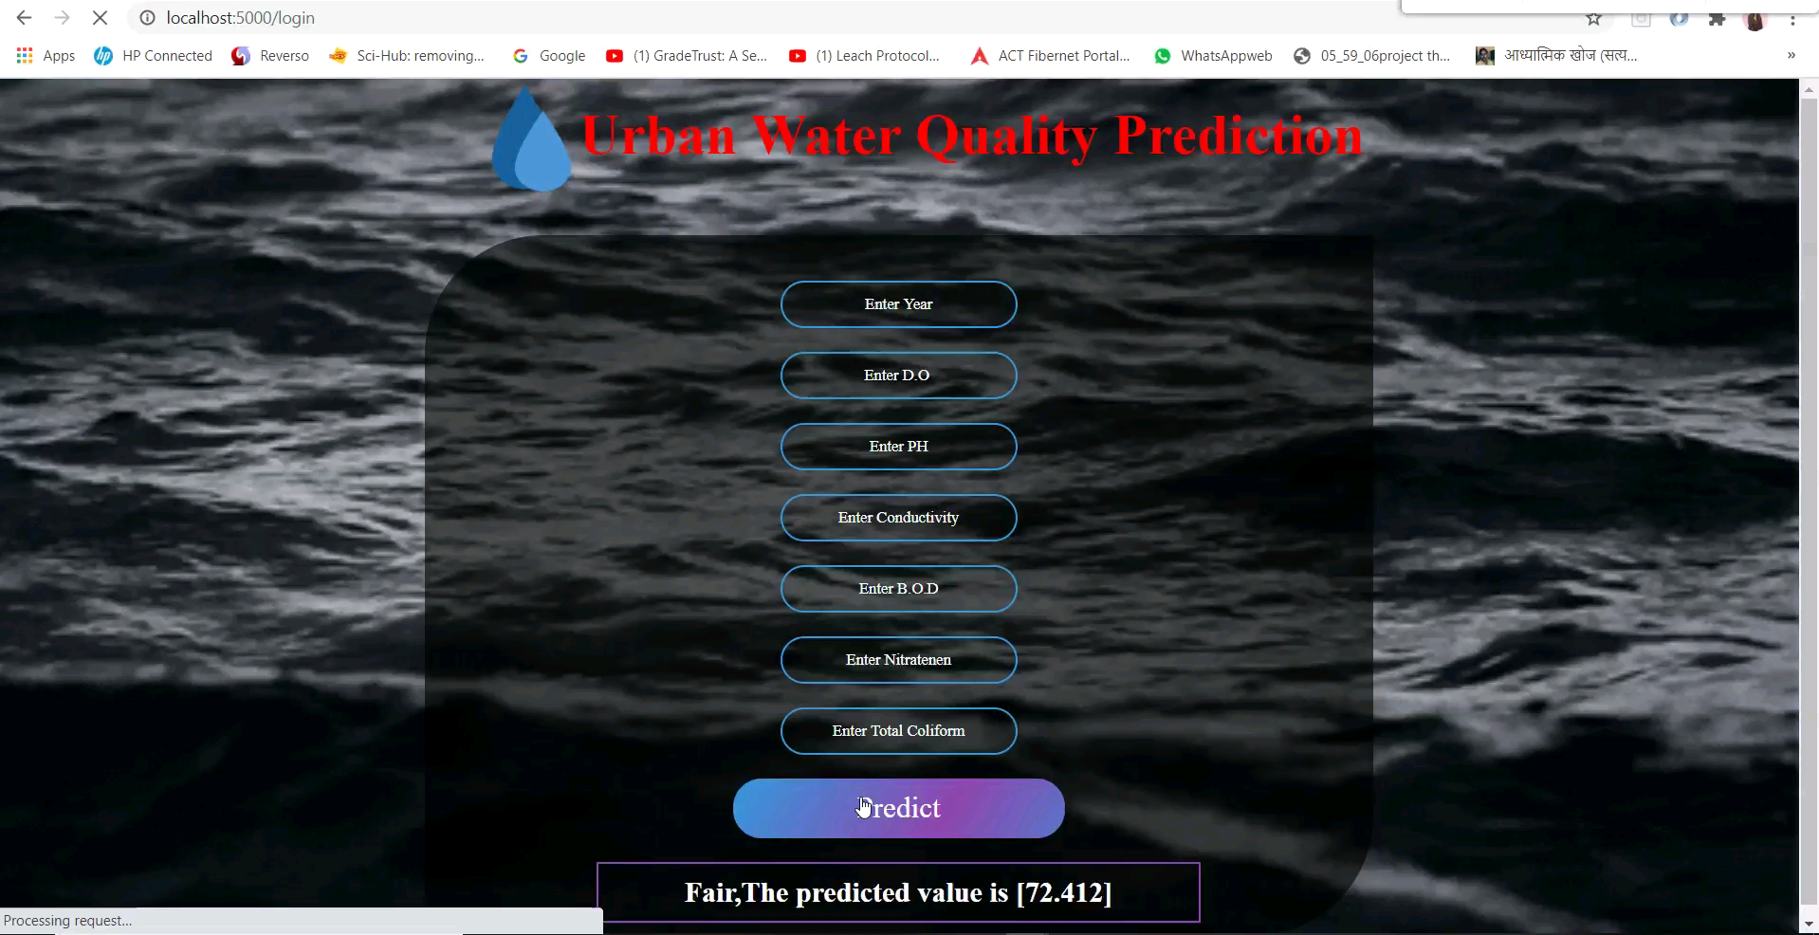

Slide 9
ADVANTAGES AND DISADVANTAGES
>>> Water quality specialists use models for many purposes: Assessing water quality conditions and causes of impairment. Predicting how surface waters will respond to changes in their watersheds and the environment (e.g., future growth, climate change).
>>> The economic performance of a waterflood or a water disposal project can be significantlyaffected by suspended solids in the injection water. Here are methods and a theory that canbe used to interpret water quality data obtained with membrane filters or cores and to predict.

Slide 10
APPLICATIONS
Prediction of water quality is a critical issue because of its significant impact on human and ecosystem health. This research aims to predict water quality index (WQI) for the free surface wetland using three soft computing techniques namely, adaptive neuro-fuzzy system (ANFIS), artificial neural networks (ANNs), and group method of data handling (GMDH).

Slide 11
CONCLUSION
The findings of this study could be used as an effective reference for policy makers in the field of water resource management. Decreasing variables, reduction of running time, and high speed of these approaches are the most important reasons to employ them in any aquatic environment worldwide.
By the end of this project:
------we’ll be able to understand
------Regression and Classification Problems
-------To grab insights from data through visualization.
-------Applying different algorithms according
-------Evaluation metrics
------- how to build a web application using the Flask framework.

Slide 12


